Slide 1

Marketing Effectiveness
& Strategy
CoolTShirts Marketing
Iain Duguay
7/29/18

Slide 2
Table of Contents
Overview of CoolTShirts in-flight marketing
What is the user journey?
Where can we optimize the campaign budget?

Slide 3
In-Flight Marketing

Slide 4
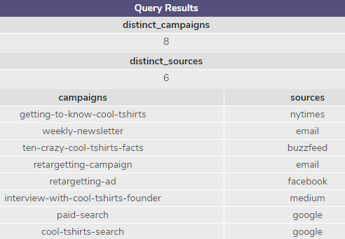
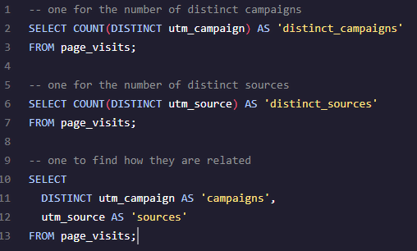
How many campaigns/sources does CoolTShirts use?
CoolTShirts has 8 in-flight campaigns using 6 distinct sources. The list of campaigns and their respective sources are on the right
Campaign: the specific messaging we use (like a weekly newsletter or a retargeting ad)
Source: The place that sent the traffic to our website (Facebook would be the source in the retargeting ad example above)

Slide 5

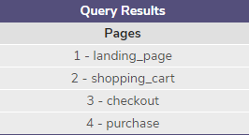
What pages are on the website?
For the purposes of our marketing campaigns, there are 4 pages we care about on the website:
Landing Page
Shopping Cart
Checkout
Purchase

Slide 6
What is the user journey?

Slide 7
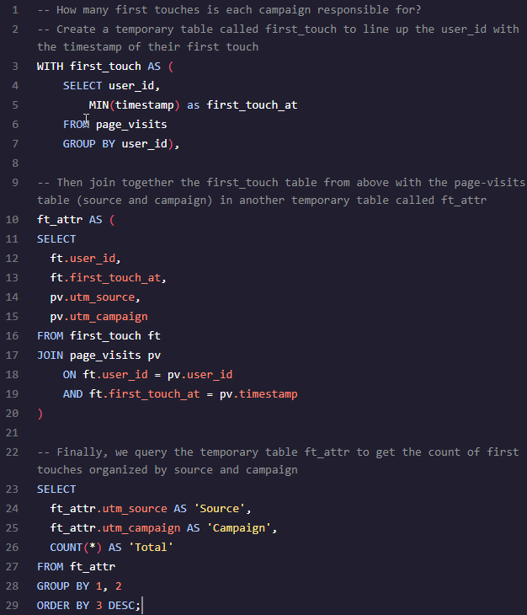
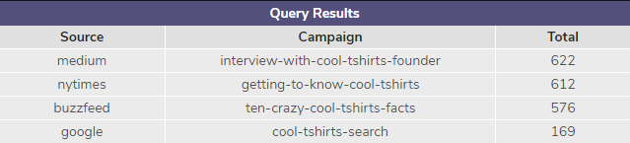
How many first touches is each campaign responsible for?
We can look at the first timestamp for each unique user on our website to tell the first touch to attribute to their eventual sale. This is the first campaign that brought awareness to our offer
Half of our campaigns (4 of 8) led to all first touches in the list below

Slide 8

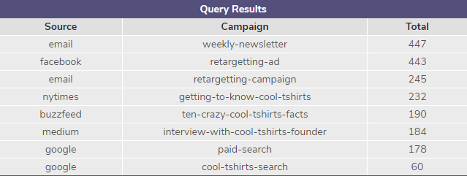
How many last touches is each campaign responsible for?
Likewise, we can look at the last timestamp for each unique user on our website to tell the final touch before they purchased a t-shirt

Slide 9
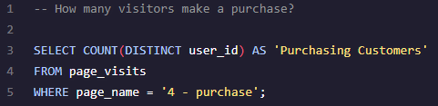

How many visitors make a purchase?
We had 361 customers make it through to the purchase page on the website

Slide 10
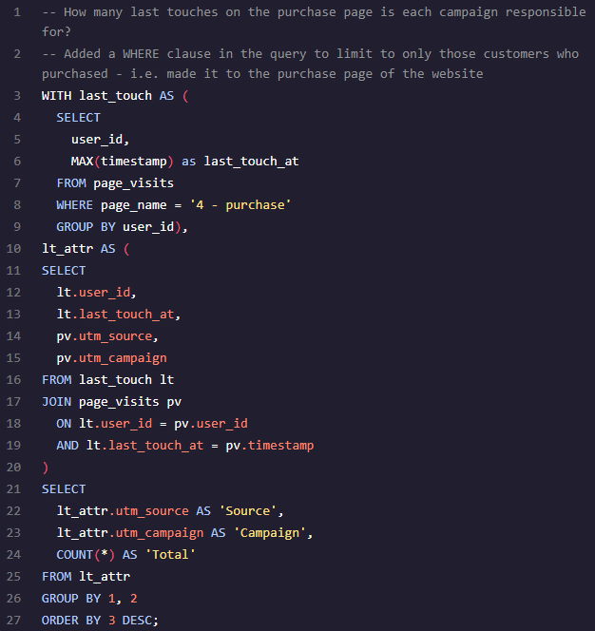
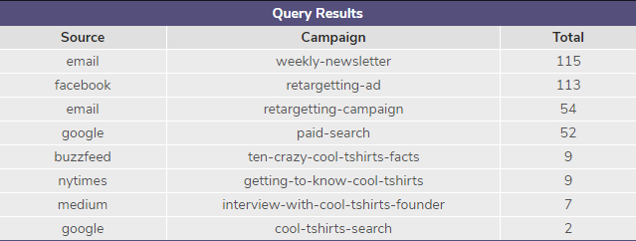
How many touches on the purchase page is each campaign responsible for?
Look at the last touch for our purchasing customers, we can see below the total counts for each of our 8 campaigns
Our weekly email newsletter and Facebook retargeting campaigns were our most effective campaigns during this time period

Slide 11
What is the typical user journey?
For the people who bought our t-shirts, their first connection with our messaging came from only half of our active campaigns
Our best results came from t-shirt related articles on Medium, New York Times, and Buzzfeed
Google search was by far the least effective way to start the user’s journey
While the articles served as our most effective kick off to the user’s journey, our reminders and persistent messaging was the main driver in completing the sale
Our weekly email campaign and targeted Facebook remarketing messages were the principle drivers of sales after the user had initially heard of us.
The initial article messages rarely lead to sales (only 27 of 361 sales came directly from the 4 articles)

Slide 12
Optimize the campaign budget

Slide 13
What 5 campaigns should CoolTShirts reinvest in?
There are 3 articles that drive significant awareness of the CoolTShirts brand: articles on Medium, New York Times, and Buzzfeed
These campaigns should be invested in to continue to grow awareness and the top of the sales funnel
However, our best sales numbers come from weekly touchpoints in the form of our email newsletter, and specific retargeting messages on Facebook
In addition to the top of the funnel boosting articles, we should focus on continuing to get our message in front of potential customers to stay top of mind until they are ready to purchase
5 campaigns to boost investment:
Medium article: Interview with CoolTShirts Founder
New York Times article: Getting to know CoolTShirts
Buzzfeed: Ten Crazy Cool T-Shirts Facts
Weekly email newsletter
Facebook retargeting ad

